Slide 1

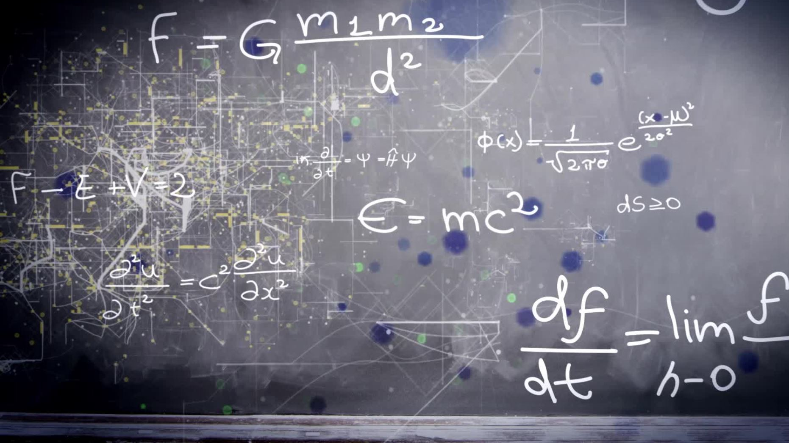
Parallelization of Linear Equations
Bailie Delpire, Joseph May

Slide 2
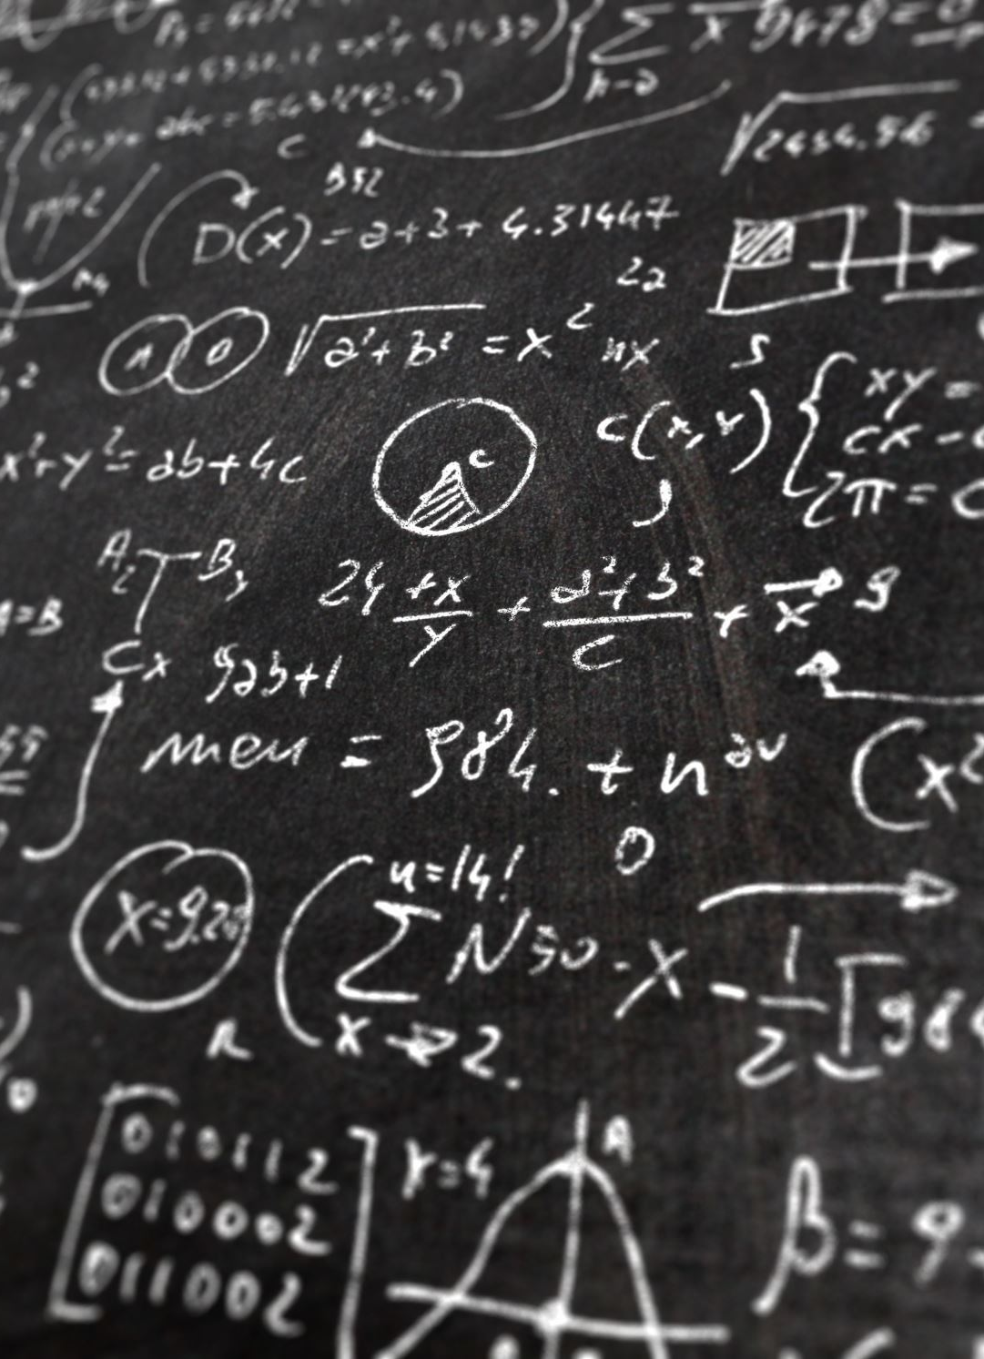
Abstract
Linear algebra is a branch of mathematics dealing with vectors and matrices.
The goal of our project is to solve a system of linear equations using parallel methods to introduce better speed and efficiency for applied problems in the linear algebra space.
Notes:
The need for data processing has increased and the size of storage structures has grown rapidly. The ability to process these structures
and find solutions to linear systems has become more important in fields such as statistics and graphics processing.

Slide 3

Introduction
We first divided the task into two main areas
Finding a mathematical method to solve linear systems
Applying parallelization methods and strategies for linear systems.
Notes:
Linear Algorithm:
The literature suggested a number of mathematical algorithms such as Gaussian Elimination, Conjugate Gradient, Sherman-Morrison,
Woodberry, and the Newtonian and Chebyshev methods to solve linear equations. Each algorithm comes with unique computational costs and
constraints. Our first task was choosing an algorithm that we could feasibly code, but also had acceptable run times and the capability to be parallelized.
Parallelization:
After algorithmic selection, our second task was parallelization. We had to decide where parallelization was most appropriate, from the instruction stream, the data stream, or both, based on the algorithm we chose. And from there, we had to decide on messaging protocols, data sharing, and look to optimize our algorithm.

Slide 4

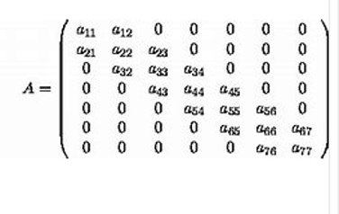
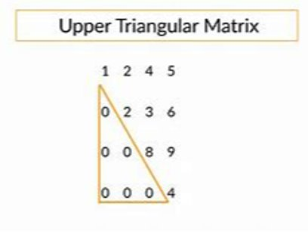
Matrix Shape
Notes:
The shape of a matrix determines what types of math operations can be applied to that matrix.
For instance Multiplication, addition, and subtraction all require a matrix to be of compatible dimensions. Square matrices can be decomposed, while others may not.
The determinant can only be calculated for Square matrices
Matrix shape is incredibly important for solving linear equations because each algorithm comes with its own prerequisites. Some require matrices to be square, that is NxN,
others require the data to be in specific formatting prior to solving, which introduces preprocessing overhead.
The shape of the matrix data determines the preprocessing needs, and how work can be divided amongst threads.
Pictured here are two types of matrices
Upper triangular matrix - Where all elements below the main diagonal are zero. This is done in gaussian elimination, although
The matrix pictured here is not in the correct gauss format as the pivot values are not all ones
Also pictured is a diagonal matrix
Where information stored on the main diagonals dominates other values,
In our images case, the diagonal values are the only values in the matrix
Computation time rises as the size and complexity of the linear system increase
Certain speedup techniques require calculating derivatives or enforcing other constraints.
The more you must calculate the more work the computer needs to do.
The shape the data is in determines what types of methods you can use to preprocess the data.

Slide 5
Jacobi Iteration: Tutorial
Given a linear system such as:
A) 3x +1y + 2z = 9
B) 2x + 4y +1z = 8
C) 4x + 4y + 12z = 20
Step1. Solve for one variable per row
D) x = (9 - y -2z)/3
E) y = (8-2x-z)/4
F) z = (20-4x-4y)/12
Notes:
We chose the Jacobi iteration algorithm to process our data to solve linear system of equations.
Referring back to matrix shape, jacobi iteration works best for nonsingular matrices that are diagonally dominant.
Jacobi iteration is an iterative algorithm. This means it does not typically arrive at an exact solution to the linear system.
Rather, it solves the system with values that are close to the exact.
The program will continue iterating until the error, the difference between the expected value and the actual value, is below an accuracy threshold, commonly assumed to be .1
Here we have an example
We have some defined linear system of equations
Our example has 3 rows row A row B and row C, and 3 unknown variables X, Y, and Z.
Step one of jacobi iterationis to solve each row for one unknown variable
Which we have done on D E and F
D solves the system for X
E solves the system for y
And F solves the system for Z

Slide 6
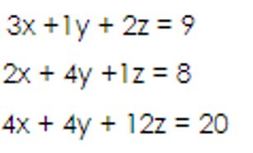
Jacobi Iteration: Tutorial
Step 2. Assumed values (x=0, y=0, z=0)
Step 3.
G) x = (9 - 0 -2(0))/3 --> x = 9/3 = 3
H) y = (8-2(0)-0)/4 --> y = 8/4 = 2
I) z = (20-4(0)-4(0))/12 --> z = 20/12 = 1.66
Notes:
Step 2 in jacobi iteration is to assume a value for each variable
The better the assumption, the fewer iterations are required to arrive at the answer, and the faster the process goes.
If you have no useful information, and the domain permits it, It is easiest to assume 0 when starting out.
Here, we assume the values of the unknown variables all to be equal to 0
Plug in the assumed values of each variable to the equation, and compare the answer to the expected answer for error
Step 3 of jacobi iteration is to plug in the assumed value of each variable back into the equation
This first iteration, all values are assumed to be 0.
The original matrix is pictured on the right for your reference.
G contains the results from our attempt to solve for x. Plugging in 0 for all variables into our equation
Results in a value of 3
H contains the results from our attempt to solve for y. Plugging in 0 for all variables into our equation
Results in a value of 2
I contains the results from out attempt to solve for y. Plugging in 0 f for all variables into our equation
Results in a value of 1.66
After this iteration of jacobi iteration we now have values for each unknown in our equation
Those being x equals3, y equals 2, and z equals 1.66

Slide 7
Jacobi Iteration Tutorial
Step 4. Use these values as input to the original system
J) 3x +1y + 2z = 9 becomes 3(3) + 2 + 2(1.66) = 9
K) 14.32 = 9
L) 2x + 4y +1z = 8 becomes (3) + 4(2) + 1.66 = 8
M) 15.66 = 8
N) 4x + 4y + 12z = 20 becomes 4(3) + 4(2) + 12(1.66) = 20
O) 39.92 = 20
Notes:
Step 4 of jacobi iteration is to use those values we just gathered, x equals 3, y equals 2, and z equals 1.66
And use those values in our equation to see if they match up.
At J we plug in the values into our equation. We see the results of this at K
Where we see that our resulting answer is the statement 14.32 equals 9
At L we plug in the values into our equation. We see the results of this at M
Where we see that our resulting answer is the statement 15.66 equals 8
At N we plug in the values into our equation. We see the results of this at O
Where we see that our resulting answer is the statement 39.92 equals 20

Slide 8
Jacobi Iteration: Tutorial
14.32 = 9
15.66 = 8
39.92 = 20
Notes:
You can see the results of our iteration on screen.
After the first jacobi iteration, no values matched or were close to the target value. For instance, there is a difference of 5.32 between 14.32 and 9.
This error margin is too great to stop iterating.
And so, the algorithm would proceed in the same steps.
1. Assume a value for a variable
2. Use that value as input for a given row equation
3. check to see if the assumed value results in the correct answer to some error margin
4. If not, keep iterating using the newest assumed values as inputs to the next loop.

Slide 9

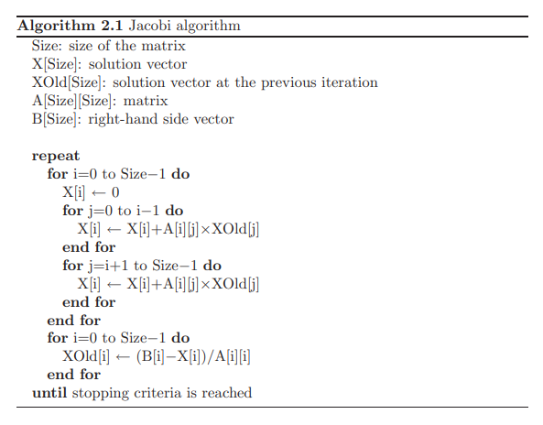


Jacobi Iteration
Notes:
Here we have some pseudo code implementing the jacobi algorithm.
We just ran through the algoritihm so we don't need to get too into the specifics, but importantly at the top
You can see there are 4 matrices used in the algorithm
X which will hold solution values
Xold which will hold values from past iterations
A which holds the entire linear system
and B which holds just the right-hand side values of the system
This is important for us as consider efficiency and memory.
We have to store the array itself, which is assumed to be large.
Store two rows dimensions because X and Xold record a coefficient value for each item in a row
And we need to keep one columns dimension because B is the right-hand side column information.
Jacobi iteration is a nice algorithm but it's important to be aware of its memory requirements.

Slide 10
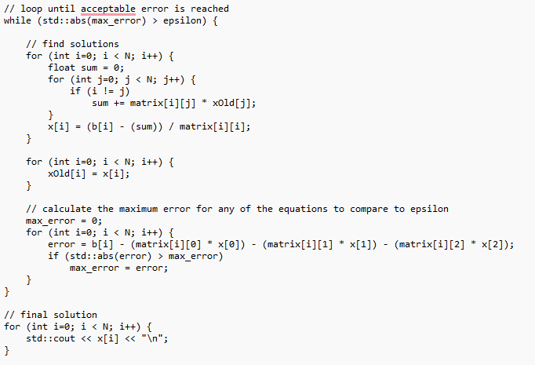
Starting Out:
Notes:
At this point, we had selected an algortihm to use and we just had to implement it.
The code here pictured on the right here is our proof of concept which solves specifically one single example linear system that we found online.
You can see here that we follow the steps we discussed above.
We continue to loop forever until an acceptable answer is found.
The first for loop the inner portion will get the value of a row by adding each element times its assumed value
Then the outer portion of the loop will get the new assumed value as it solves for each variable
We share the results and keep the old assumed values from one iteration previous and new values
Then at the bottom we calculate the error.
Once we had our proof of concept
we needed to generalize the algorithm to work for any problem,
and we needed a dataset of matrices to work on to test how effective our parallelization was.

Slide 11
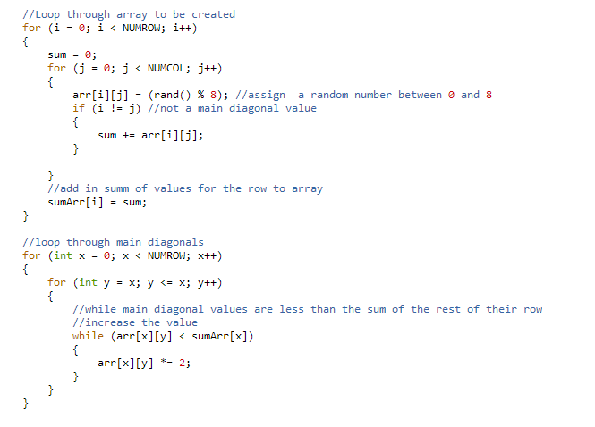
Creating a dataset
Notes:
To make our dataset we made a program that randomly generated random values into an array.
The sizes of the arrays could be changed through defined constants NUMROWS and NUMCOLS. The minimum size array was 500x500.
The top portion of the code will loop through the whole array, assigning each index a random number that started out in some value in the range 0-7.
We modified this to randomly assign negative values, and have also tweaked the range of random variables since we started.
As we got up and running we wanted only to test on matrices where we knew an answer could be found.
And so, once the random numbers were assigned, we had to make sure each array was diagonally dominant.
The second for loop in the picture is ensuring that the diagonal values in the array will be incremented until they dominate over the other array values.

Slide 12
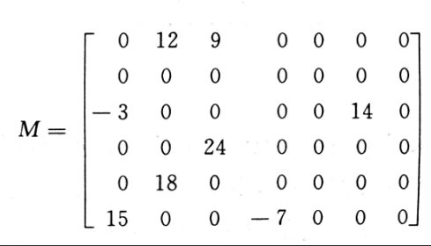
Different Datasets
Sparse
Very Sparse
Upper Triangular
Negative values
Notes:
In an effort to get as much data as we could, we generated different types of matrices to see what type worked best and compare algorithm performance.
We compiled some statistics on how the algorithm performed for different types of matrix data which we'll get into later

Slide 13
Code for sparse & very sparse array
while(zeroCount < majorityZero)
for (i = 0; i < numRow; i++)
sum = 0; //reset row sum for each row
for (j = 0; j < numCol; j++)
//give chance to be 0s
iszero = rand() %2;
if(iszero == 0)
arr[i][j] = 0;
else //assign random value
//assign a random number between 0 and 7
arr[i][j] = (rand() % 8);
//randomly assign some values to be negative
////must check equal to -1, otherwise could be 0 and you'd null out matrix values
if ( rand() % 2 *-1 == -1)
arr[i][j] *= -1;
if ( arr[i][j] == 0)
zeroCount++;
Notes:
Notice we enforce a certain number of zeroes to be put into the arrays. That is calculated to be 70% 0 values for our very sparse arrays,
50ish percent for sparse arrays. 50ish because the number isnt enforced, its just on average the way we assign random numbers
About 50% of the values will be 0s. The code for regular sparse arrays is the same as what's on screen, just withouth the while loop.

Slide 14
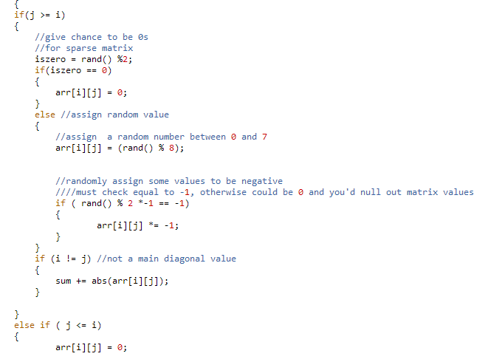
Code for upper triangular matrix
Loop though the arrays
Diagonals are where I==j
If the column is greater than or equal to the row count, assign some random value, this will be the upper part of the triangle
If the column is less than the row count, assign the value to be 0. This will be the lower part of the triangle.

Slide 15
Recap
Solving systems of linear equations can take a lot of time and resources
3x +1y + 2z = 9
2x + 4y +1z = 8
4x + 4y + 12z = 20
Our project: solve using parallel methods
Pthreads
OpenMP
MPI
3 | 1 | 2
2 | 4 | 1
4 | 4 | 12
x
y
z
9
8
20
=

Slide 16
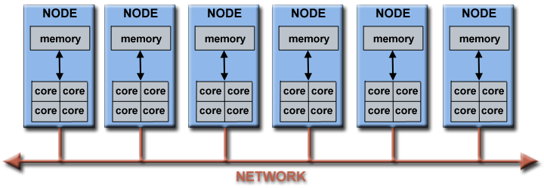
Parallel targets and strategies
Notes:
At this point in our project, we had a working algorithm that would solve linear systems.
And a way to create data to test and benchmark our solution.
Our next consideration was parallelization.
All of our data is stored in arrays
All of our processing is done inside of for loops.
This is great for us because Loops and arrays are good targets for parallelization.
We selected the Jacobi method because it allows us to treat each row independently of the others.
Each matrix row can be assigned a thread to execute calculations for that row.
Which means in the ideal situation the number of threads will be equal to the number of rows in the matrix.
At the end of each calculation, the estimated values of the variables need to be shared for the next round of guesses.
And then the threads can continue on repeating row operations until the system has been solved within the error margin.

Slide 17
Strategy
Divide matrix up by rows
Task 1
Task 2
Task 3
A x = b
=

Slide 18
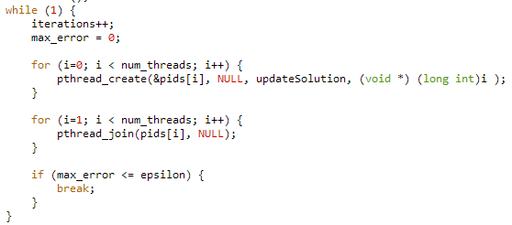
Pthread Jacobi

Slide 19
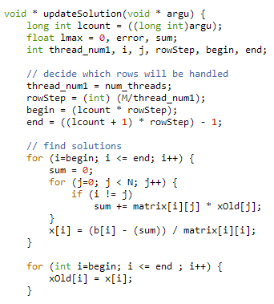
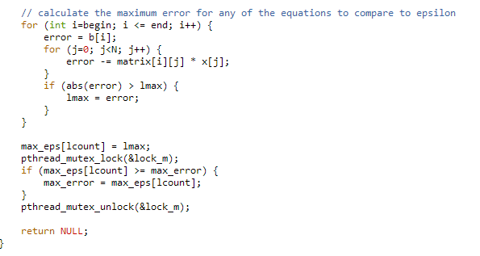
Pthread Jacobi

Slide 20
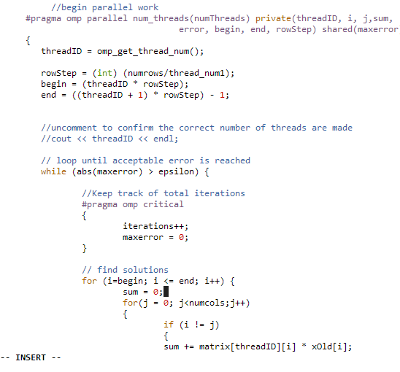
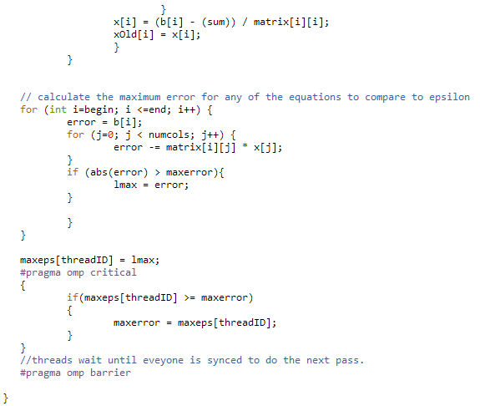
OpenMP Jacobi

Slide 21
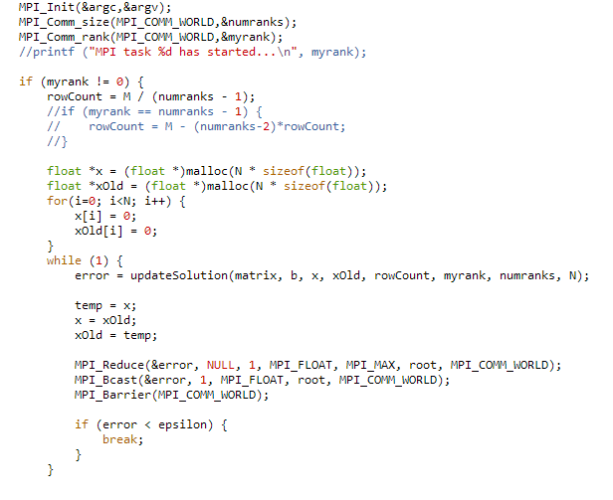
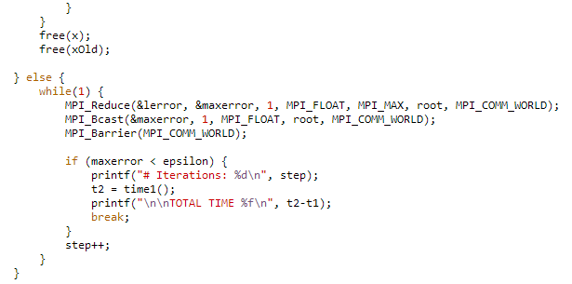
MPI Jacobi

Slide 22
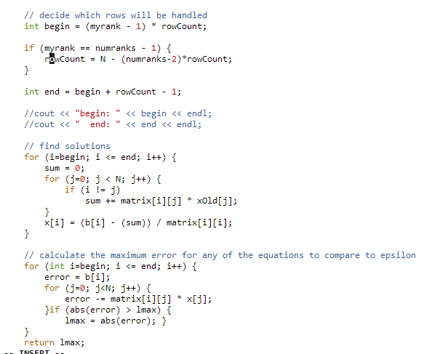
MPI Jacobi

Slide 23
Testing
Reference Matrix: 1000Matrix20.txt
1000x1000 matrix with random values
For each implementation: pthread, mpi, openMP
For each thread number 1,2,4,8 - Graphs are mislabeled 1-4, not 1,2,4,8
The program was run using 1000Matrix 20 100 times,
So Pthread was run with 1 thread 100 times, 2 thread 100 times 4 thread 100 times 8 thread 100 times. This was done with MPI, and openMP.
We recorded the times, and the accuracy and graphed them.
For val in 1 2 4 8; do ((x=0; x<100; x++)); do ./openMP ${val} 1000Matrix20.txt >> mpi-Data-${val}.txt; done; done
ls -v *.txt | xargs paste >> openMPTotal.txt

Slide 24
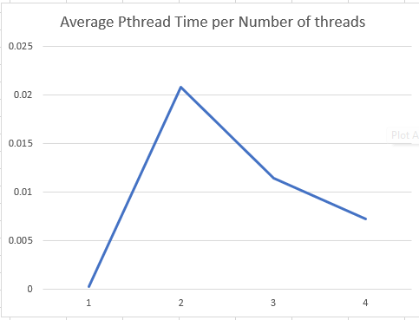
Pthread Average Times

Slide 25
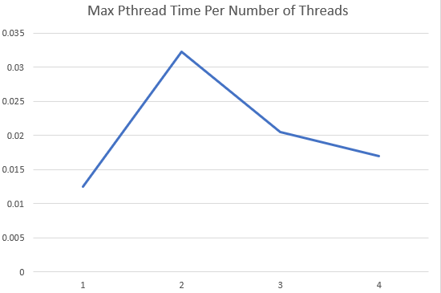
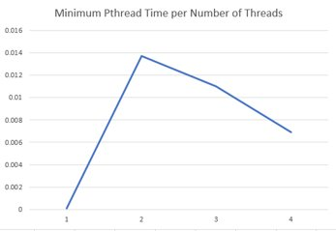
Pthread Max and Min Times

Slide 26
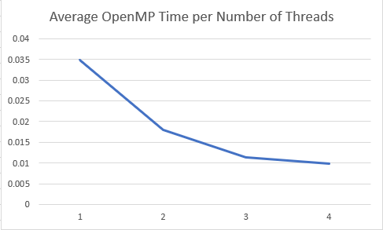
OpenMP Average times

Slide 27
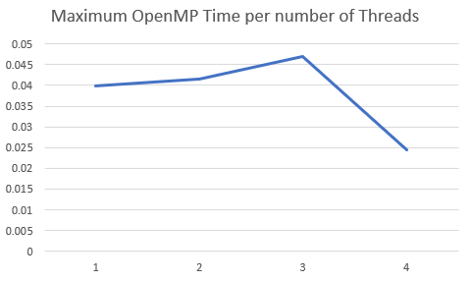
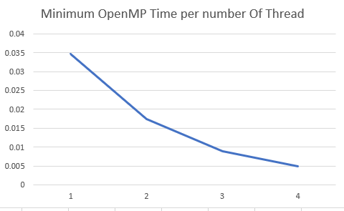
OpenMP Max and Min Times

Slide 28
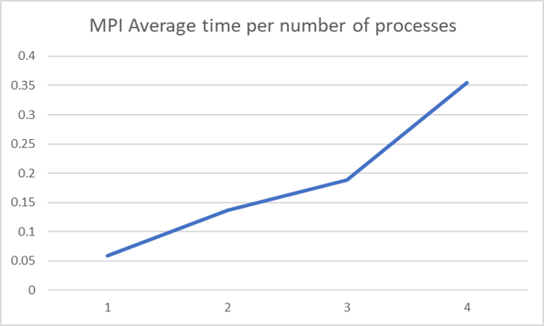
MPI Average times

Slide 29
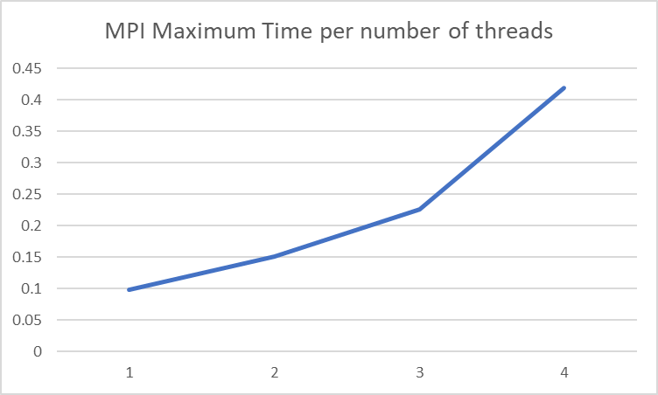
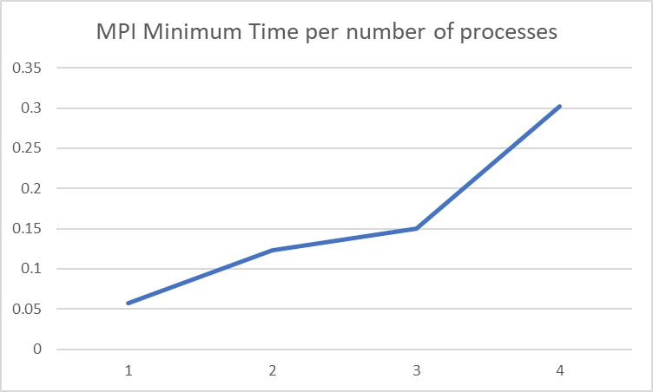
MPI Max and Min Times

Slide 30
What does this tell us
We can parallelize better
pass data more efficiently
reduce the big o of our program
Be more conscious of how efficient our loops and computations are

Slide 31
Questions?

Slide 32
Citations
[1] V. P. Gergel, “9. Parallel Methods for Solving Linear Equa- tion Systems,” University of Nizhni Novgorod. [Online]. Available: http://www.hpcc.unn.ru/mskurs/ENG/PPT/pp09.pdf [2] S. C. S. Rao and R. Kamra, “A computational technique for paral- lel solution of diagonally dominant banded linear systems,” in 2021 IEEE 28th International Conference on High Performance Comput- ing, Data, and Analytics (HiPC), Dec. 2021, pp. 448–453. doi: 10.1109/HiPC53243.2021.00064. [3] H. Gu, Y. Luo, Y. Qiu, and J. Hou, “A Fast Solution Method for Large Scale Linear Sparse Equations Based on Parallelism,” in 2022 IEEE 5th International Conference on Electronics Technology (ICET), May 2022, pp. 1337–1340. doi: 10.1109/ICET55676.2022.9824027. [4] V. Pan and J. Reif, “Efficient parallel solution of linear systems,” in Proceedings of the seventeenth annual ACM symposium on Theory of computing, New York, NY, USA, Dec. 1985, pp. 143–152. doi: 10.1145/22145.22161. [5] S. Maruster, V. Negru, and L. O. Mafteiu-Scai, “Experimental Study on Parallel Methods for Solving Systems of Equations,” in 2012 14th Inter- national Symposium on Symbolic and Numeric Algorithms for Scientific Computing, Sep. 2012, pp. 103–107. doi: 10.1109/SYNASC.2012.73. [6] Q. Chunawala, “Fast Algorithms for Solving a System of Lin- ear Equations | Baeldung on Computer Science,” Apr. 22, 2022. https://www.baeldung.com/cs/solving-system-linear-equations (accessed Sep. 02, 2022).
[7] T. J. Dekker, W. Hoffmann, and K. Potma, “Parallel algorithms for solving large linear systems,” Journal of Computational and Ap- plied Mathematics, vol. 50, no. 1, pp. 221–232, May 1994, doi: 10.1016/0377-0427(94)90302-6. [8] L. Yao, X. Ji, S. Liu, and J. Yang, “Parallel Implementation and Per- formance Comparison of BiCGStab for Massive Sparse Linear Sys- tem of Equations on GPU Libraries,” in 2015 IEEE 12th Intl Conf on Ubiquitous Intelligence and Computing and 2015 IEEE 12th Intl Conf on Autonomic and Trusted Computing and 2015 IEEE 15th Intl Conf on Scalable Computing and Communications and Its Associ- ated Workshops (UIC-ATC-ScalCom), Aug. 2015, pp. 603–608. doi: 10.1109/UIC-ATC-ScalCom-CBDCom-IoP.2015.119. [9] R. Peng and S. Vempala, “Solving Sparse Linear Systems Faster than Matrix Multiplication,” in Proceedings of the 2021 ACM-SIAM Sympo- sium on Discrete Algorithms (SODA), Society for Industrial and Applied Mathematics, 2021, pp. 504–521. doi: 10.1137/1.9781611976465.31. [10] M. A. Tchakorom, R. Couturier, and J.-C. Charr, “Synchronous parallel multisplitting method with convergence acceleration using a local Krylov- based minimization for solving linear systems,” in 2022 IEEE International Parallel and Distributed Processing Symposium Workshops (IPDPSW), May 2022, pp. 900–906. doi: 10.1109/IPDPSW55747.2022.00146

